Slide 1
Light Up My World
Cade Walton – Brandt Walton – Dillon Walton

Slide 2
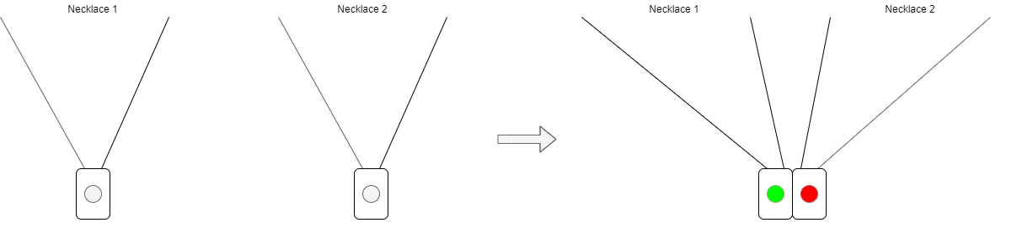
Overview
A necklace with internal electronic components that allow two or more people to turn lights on when attached to each other

Slide 3
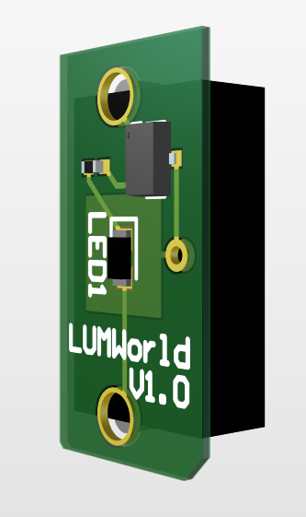
Attributes
Battery Life:
Colors:
Size:

Slide 4
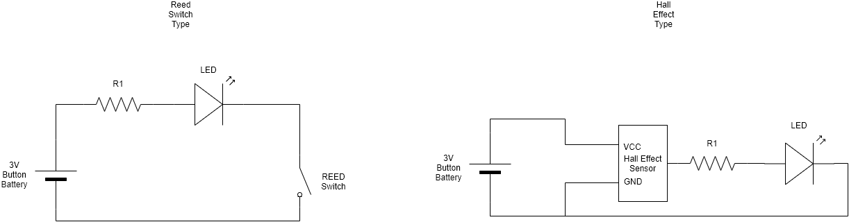
Internal Circuit
Advantages and disadvantages of REED Switch:
Vout = Vin
No leakage current
Less reliable
More expensive
Advantages and disadvantages of Hall Effect Sensor:
No forward bias voltage
No leakage current
Less reliable
More expensive

